Slide 1


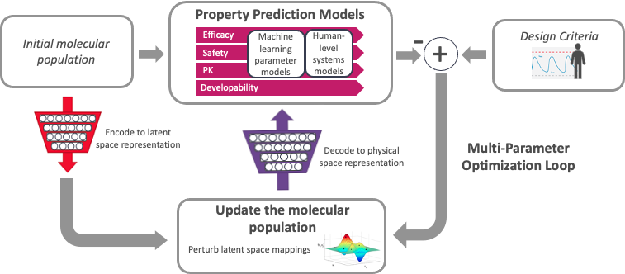


Titli Sarkar, Ph.D.
ATOM Data Scientist
Biomedical Informatics and Data Science (BIDS), FNLCR
Email: titli.sarkar@nih.gov
Accelerating Therapeutics for Opportunities in Medicine
Opportunity for Artificial Intelligence and Machine Learning in Cancer Drug Discovery
ATOM Workflow
1. AMPL Pipeline
AI and computing-driven molecular discovery and optimization
Data Ingestion + Curation
Model Training + Tuning
Featurization
Prediction Generation
Visualization + Analysis
Molecular data library Open curated and model-ready database
1. AMPL
2. GMD
Data Lake
Model Zoo
Results DB
1. AMPL (ATOM Modeling PipeLine) :
Predictive modeling: training, optimization, and property prediction
2. GMD Design Workflow
Cancer Drug Discovery (new molecules Optimized Properties)
Publicly Available Data and Models through:
GMD Pilot Project:
Neurocrine H1 Design
X-axis: M2 muscarinic receptor pKi < 6
Y-axis:H1 histamine receptor pKi > 9
(Publication will be available soon)
ATOM Science-org/AMPL
Model and Data Clearinghouse (MoDaC)
Molecules with
Optimized Efficacy
AMPL Tutorial
Curated dataset
AMPL Predictive Models
A data-sharing repository
Resources include datasets and software models
Searchable against metadata and downloadable
2. GMD: A high-performance platform for parallel optimization of efficacy, safety, and pharmacokinetics
DEPARTMENT OF HEALTH AND HUMAN SERVICES • National Institutes of Health • National Cancer Institute
Frederick National Laboratory is a Federally Funded Research and Development Center operated by Leidos Biomedical Research, Inc., for the National Cancer Institute

Slide 2
Pilot project – demonstration of the capability of AI
Very high on target and minimize off target effects
– ML makes it cheaper, not making huge number of mo Co-optimizing multiple parameters at the same time ls
DATA Sharing
Yellow LOOP – Exp. Validation
GMD -> PILOT PROJ -> YELLOW LOOP

